Slide 1
Pronago.
WE INTRODUCE YOU TO
PRONAGO

Slide 2

What is Pronago?
Pronago comes from ‘Promote National Goods’. Our aim is to create an online platform in order to promote local Indian goods and provide shopping alternatives to people. This website will allow local companies to increase their reach by advertising on our website. We’ll be having various categories for different products.

Slide 3
Why Pronago?
Pronago is here to help shoppers as well as local businesses. As local business will boost in India, it will lead to a rise in our GDP and economy. Moreover, we would like to extend a hand to all local start ups and promote them especially during this Covid-19 pandemic.​

Slide 4
Message #user-interface
Message #user-interface
How?
We have created a website in order to fulfill these needs. The user interface of this website is interactive as well as convenient for users to find Indian alternatives easily. We have various categories using which users can look for different alternatives and be redirected to the respective brand websites.​

Slide 5
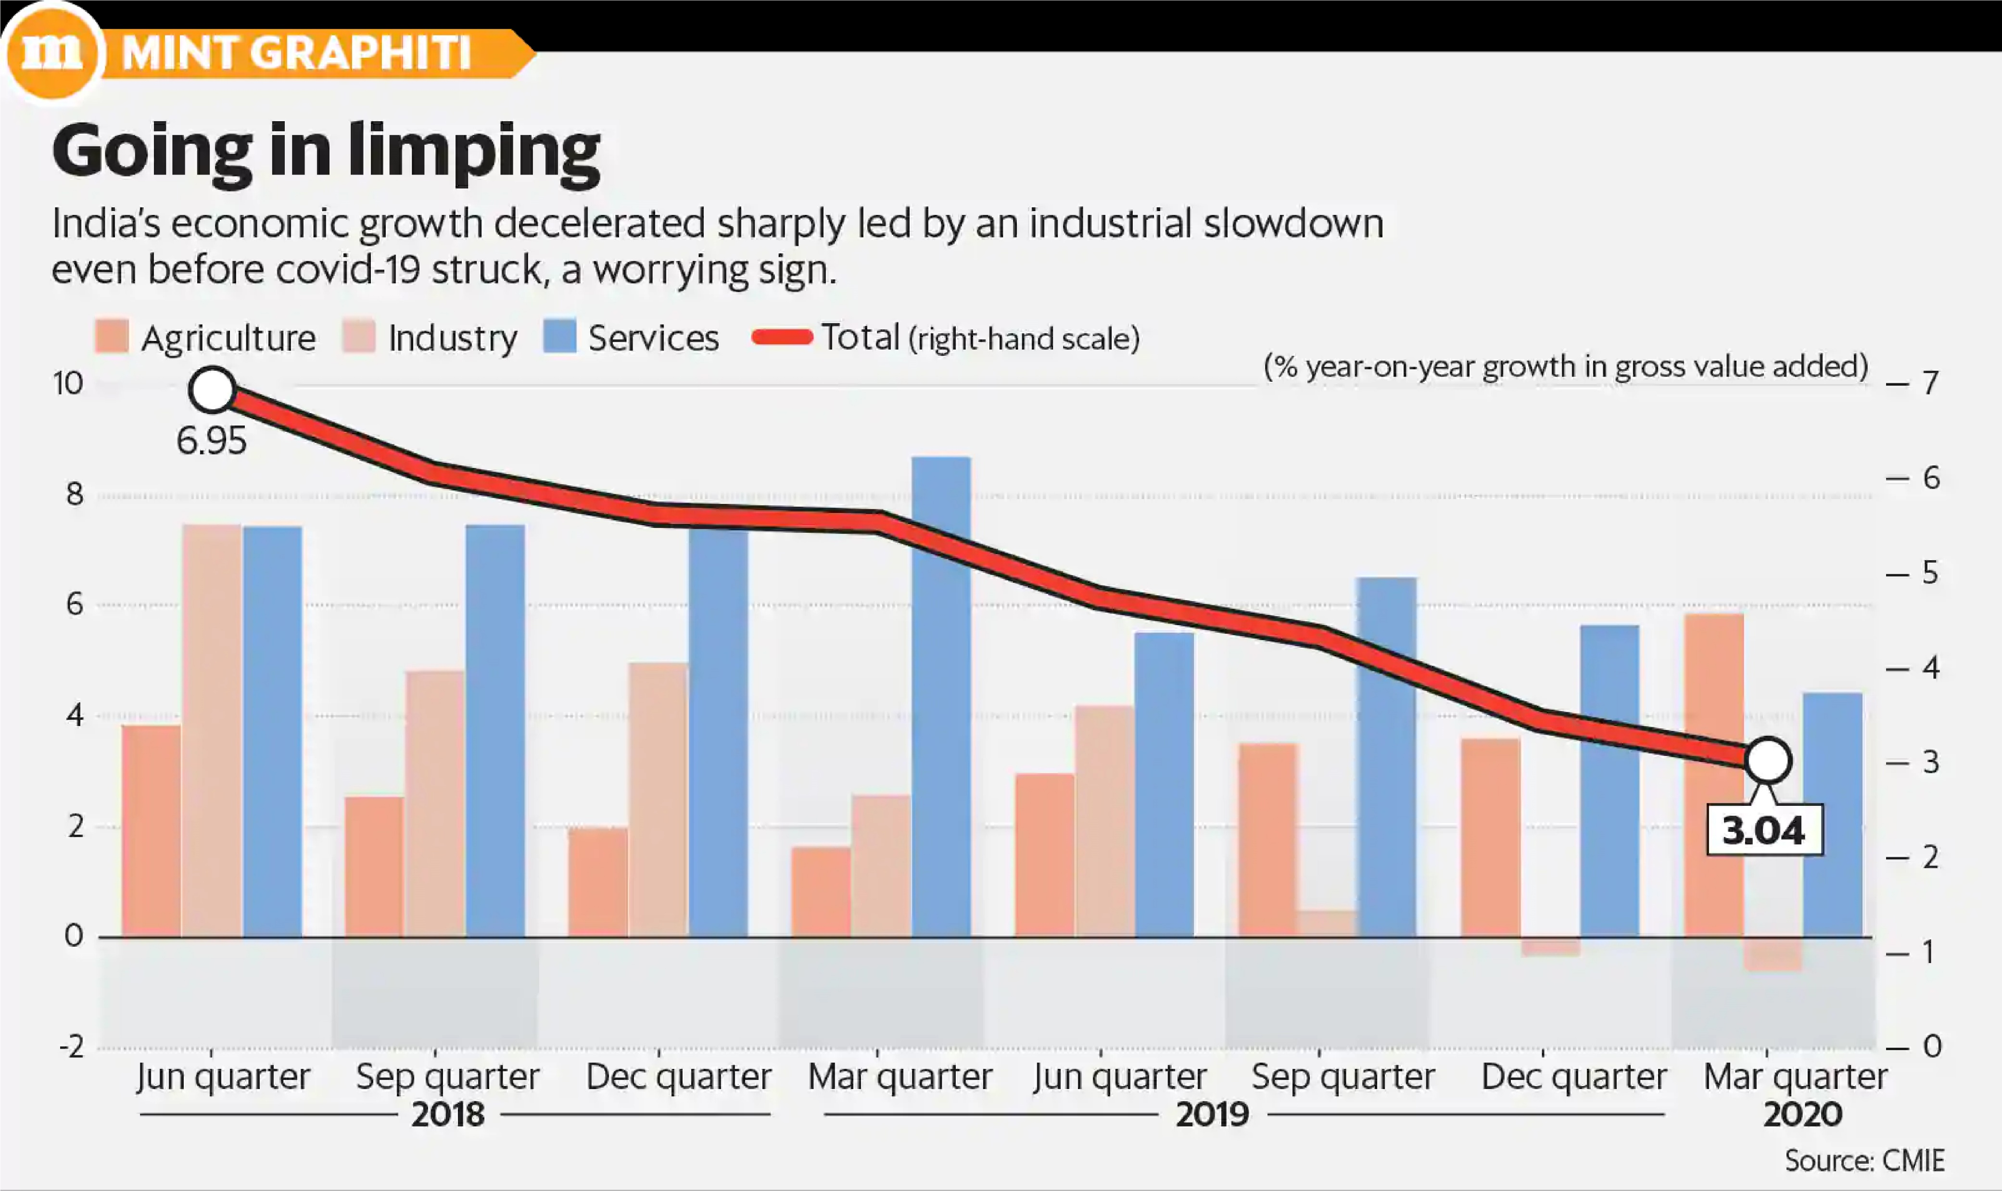
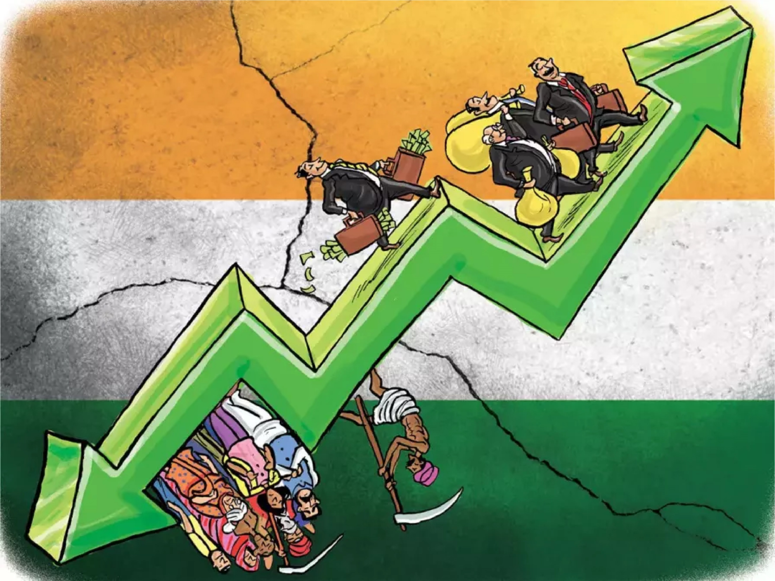
Economy
Decline in the economy of India

Slide 6
1.
Proline, Sf Jeans, Indian Terrain are some alternatives
Clothing
2.
Here we start...
Categories
Metro Shoes, Liberty Shoes, Nivia are some alternatives
Footwear
3.
Lavie, Holii, Baggit are some alternatives
Bags

Slide 7
4.
Skin
Essentials
Himalaya, Vicco, Patanjali are some alternatives
5.
Six Step Categories
infographic
Categories
Apps
JioMart, Chingari, Kaagaz Scanner are some alternatives
6.
Gadgets
Karbonn, Micromax, Crompton are some alternatives

Slide 8






Website
HTML 5 + CSS 3
Bootstrap
JavaScript
Django
PHP

Slide 9
Features
Collaborations
Since we would be open to start ups, we would have a specific form for them to contact us.
After a lot of brainstorming, here are the idea we came up with to include in our website.
Animations (UI)
We will be including different sorts of animations to make the website more appealing and attractive.
Newsletter
We hope to inform our users about the recent additions in different categories through a newsletter.
Contact Us
Want to reach us with something innovative? We’ll be taking your ideas through this feature.
Live Chat
User experience is our first priority and hence we would be having a chat option to clear your queries.

Slide 10
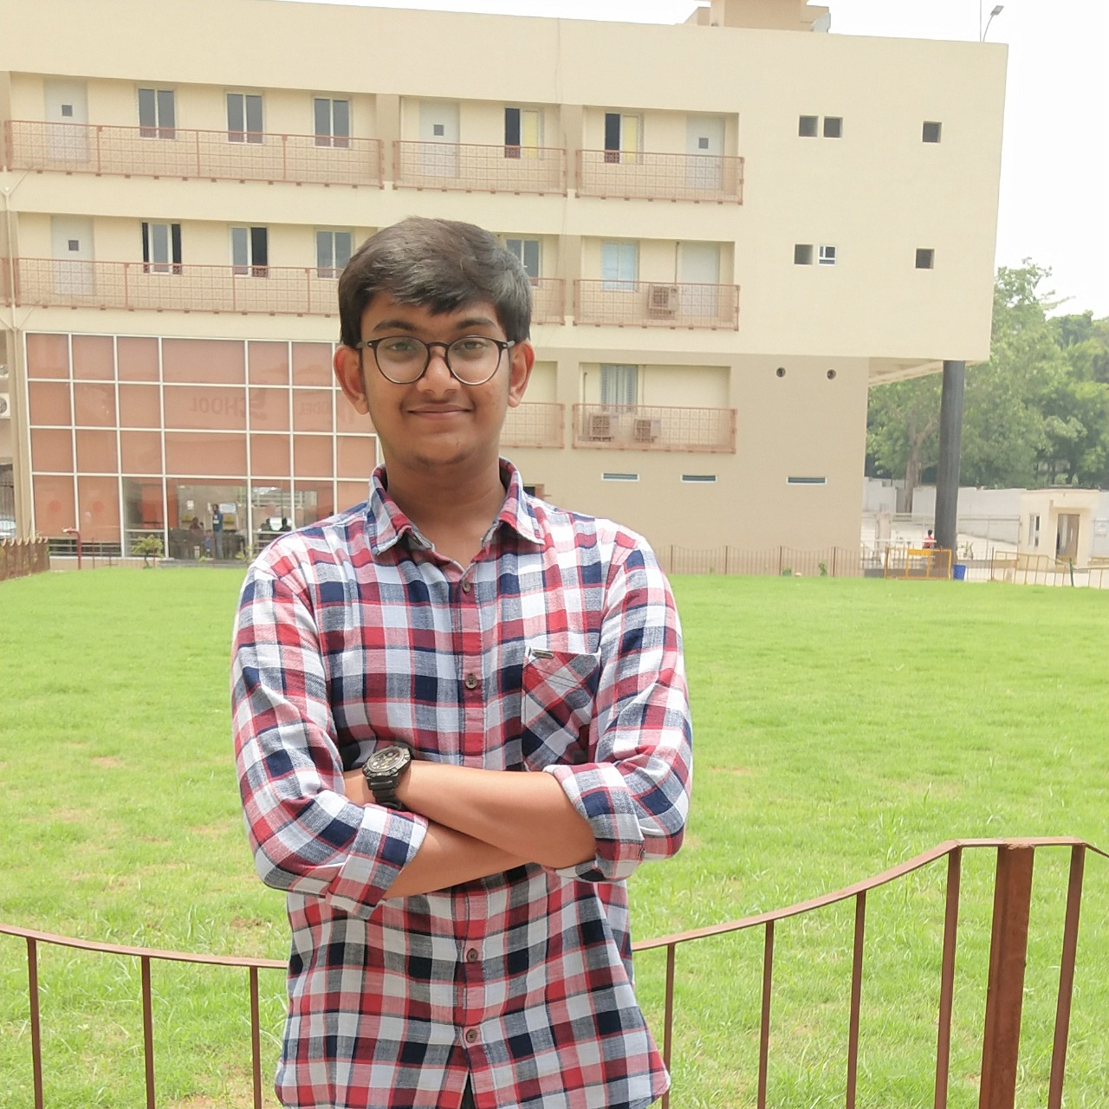


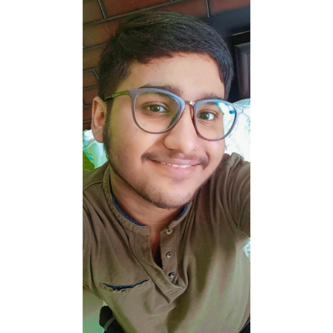
Team Members
(CODE LINGUISTS)
Ayush Agarwal
Shristi Gupta
Prajit Sengupta
Prateek Rustagi

Slide 11
Thank You

